Slide 1
Fisetin Reduces Promoter Methylation and DNA Modifying Signatures in Cancer Cells
Dr. Nazia Afroze
Manipal Academy of Higher Education, Academic City, Dubai, UAE

Slide 2
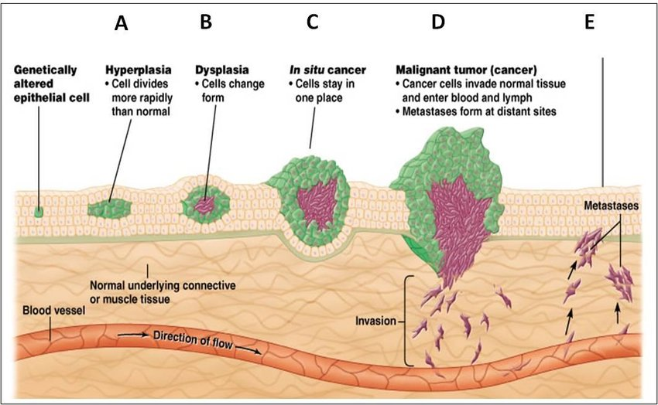
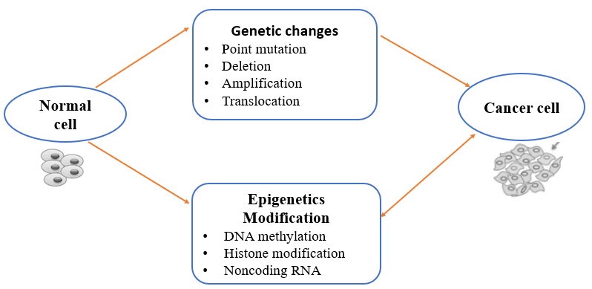
Cancer and its Prevalence
Cancer is a multigenetic, multifactorial disease
Characterized by defiant cell proliferation and evasion of apoptosis
Notes:
Cancer is a multifactorial and multigenetic disease and leading cause of death world wide after cardiac ailment. There were close to 20 million new cases of cancer in the year 2022 (including nonmelanoma skin cancers [NMSCs]) alongside 9.7 million deaths from cancer (including NMSC). The estimates suggest that approximately one in five men or women develop cancer in a lifetime, Cancer is caused by various environmental, lifestyle, pathogens, genetic and epigenetic alterations. Genetic alterations such as point mutation deletion whereas epigenetics changes such DNA methylation, histone modification and miRNA.
Both genetic and epigenetic alteration may drives the cell towards carcinogenesis.

Slide 3
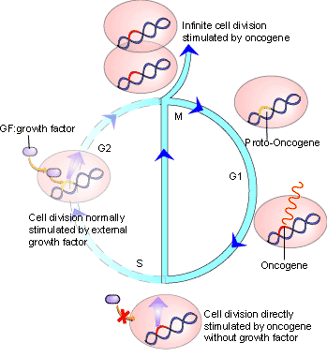
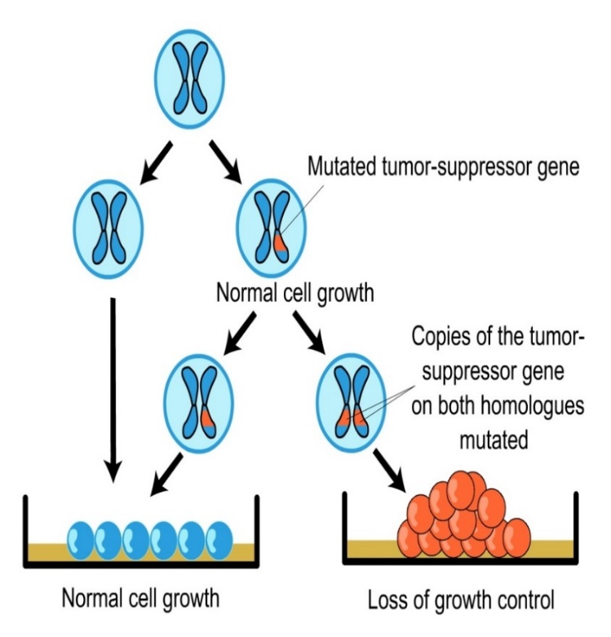
Disruption of Balance Between Cell
Death and Cell Proliferation
Oncogenes
Tumor suppressor genes
Notes:
These changes may alter the TSGs and oncogene expression

Slide 4
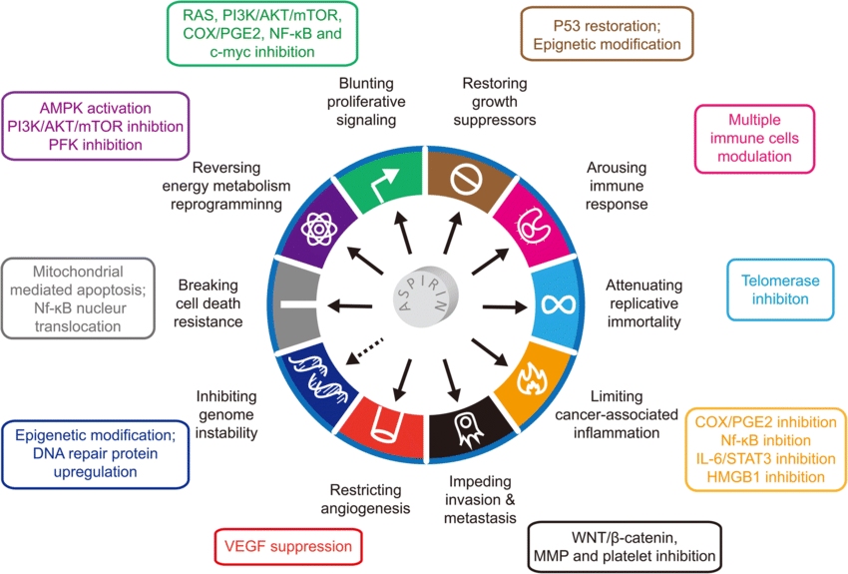
Failure of the Mechanisms that
Usually Control Growth and Proliferation
Hanahan D. et al , 2011.
Notes:
That causes transformed cell to attains different hallmarks of cancer such as-apoptosis evasion, sustained proliferation, replicative immortality, and accumulating inflammation.

Slide 5
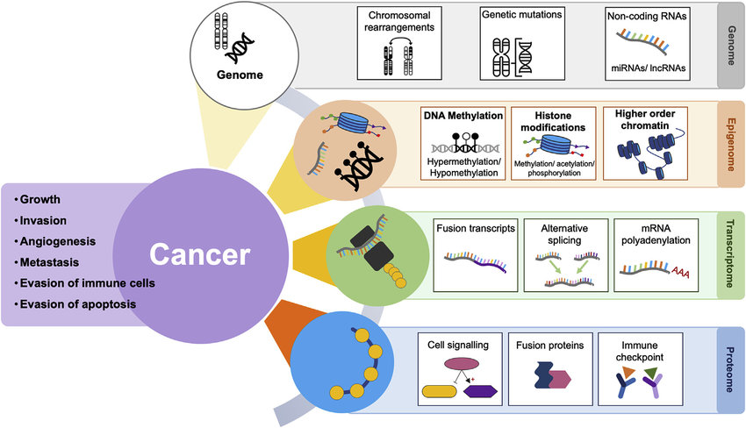
Epigenetics
Epigenetics refers to the reversible heritable change of DNA without alteration in its sequence, which accounts for change in phenotypic or gene expression
Drake et al T European Journal of Surgical Oncology, 45(5), pp.736-746.
Notes:
As mentioned earlier, cancer is caused by both genetic and epigenetic modifications.
Epigenome modification is influenced by the genome, transcriptome and proteome and thus is an important part of the complexity of cancer development.

Slide 6
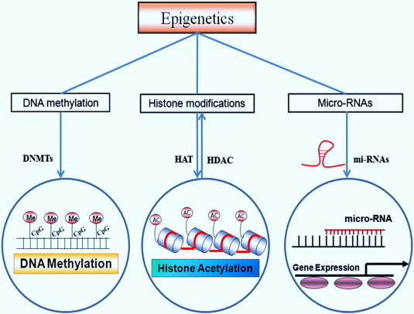
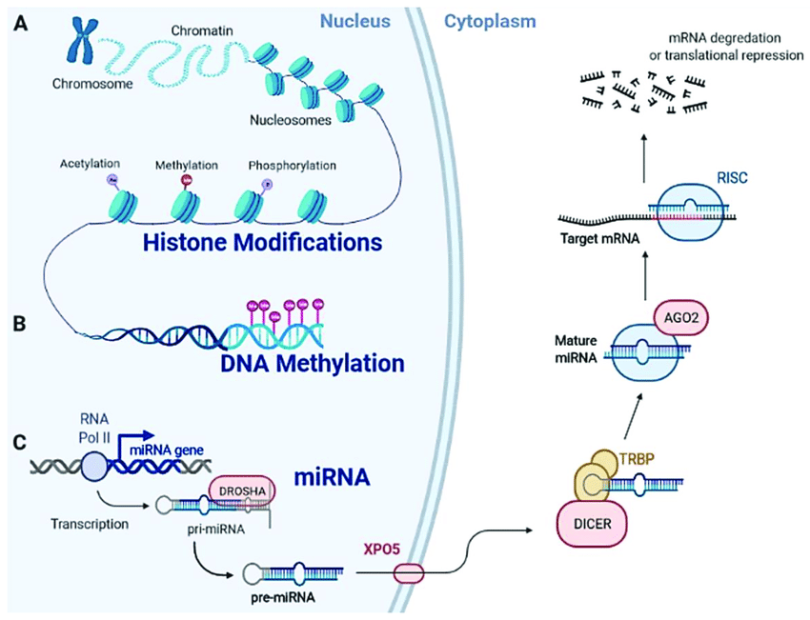
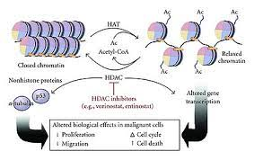
Epigenetics Modifications
P Chaturvedi et al, International journal of cardiology, 173(1), pp.1-11.
Rotondo et al. IJMS, 22(21):11464
Notes:
Various epigenetic modifications include DNA methylation, Histone modification and miRNA.
DNA methylation is carried out by DNMT, by adding methyl group to the C residue, hence converting it to 5mC.
Histone H3 and H4 are subjected to different types of modifications such as acetylation, methylation, deacetylation etc.
Acetylation of histone by HAT and deacetylation by HDAC is responsible from conversion of heterochromatin to euchromatin and vice versa.

Slide 7
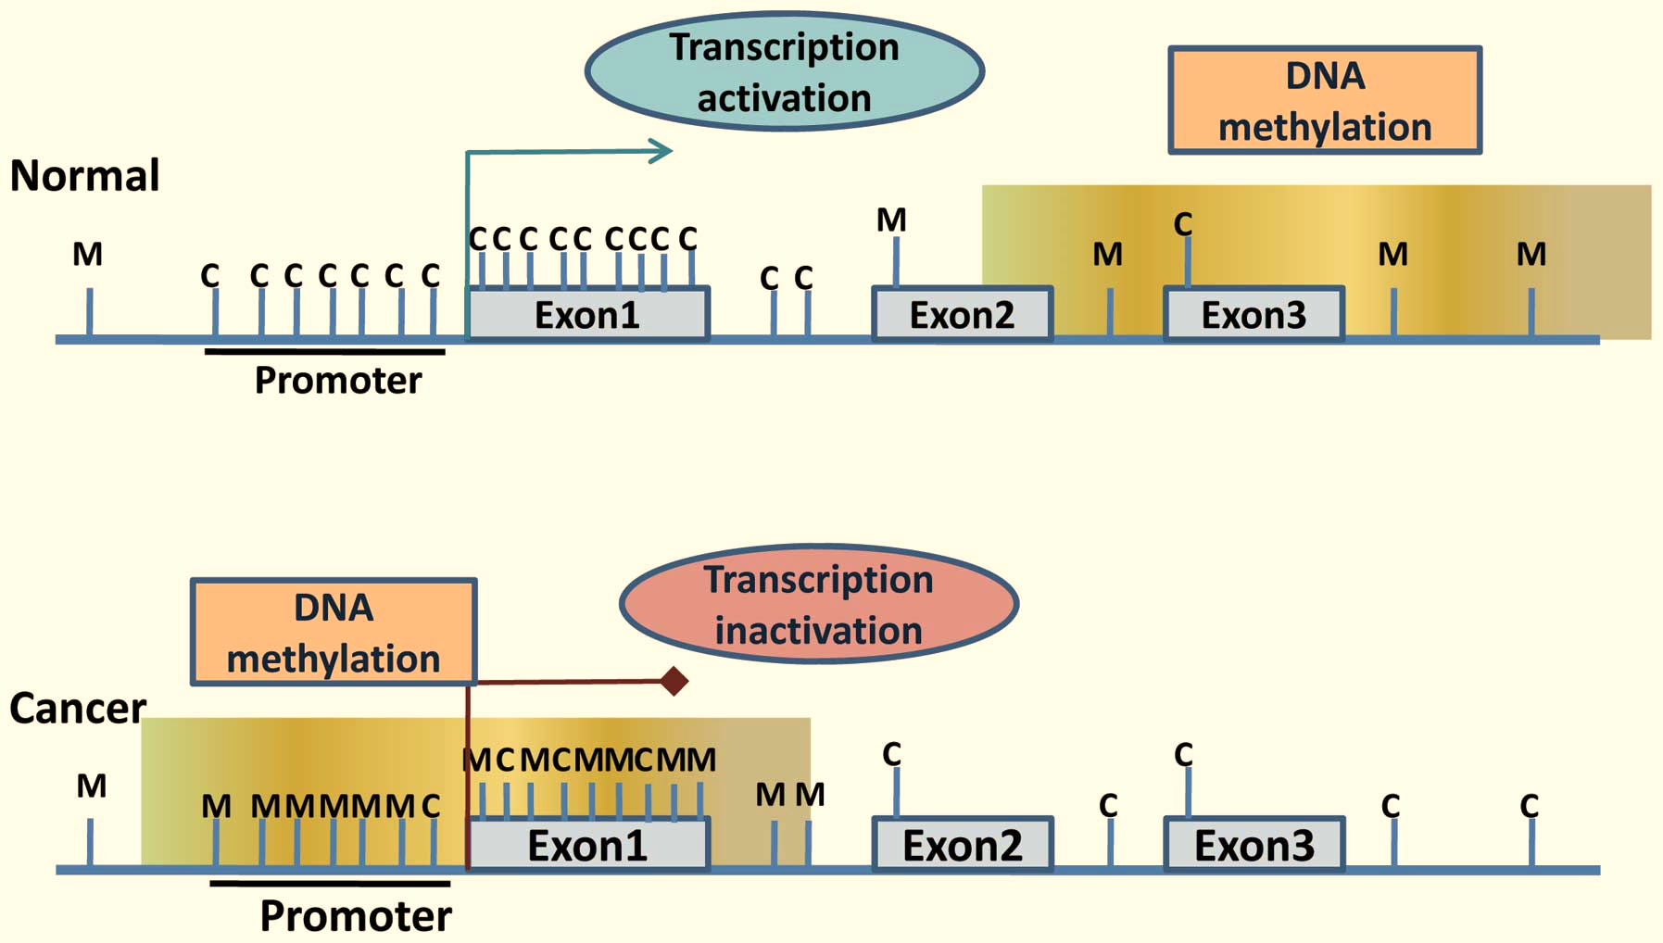
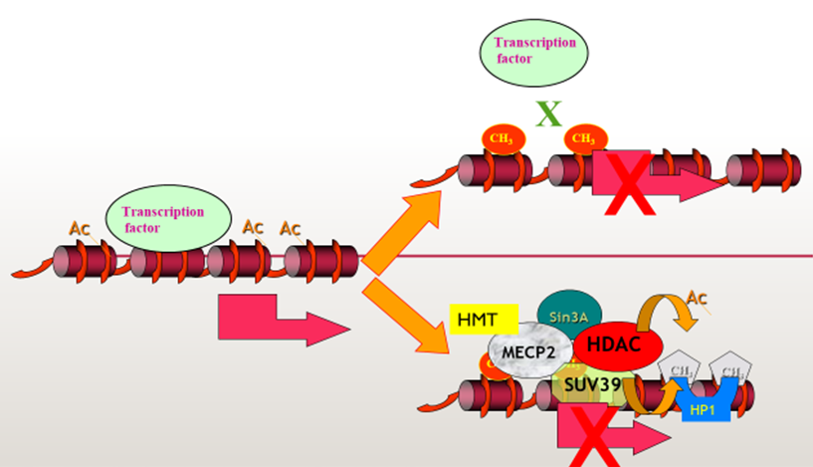
DNA Methylation and its Correlation with TSGs
Promoter hypermethylation leads to gene silencing of TSG in cancer.
Notes:
In a cancer cell, the CpG island of the promoter region is found to be methylated which causes transcription inactivation of the corresponding tumor suppressor gene. This suppression can occur either by blocking the binding of transcription factors on methylated promoter or the methylated promoter facilitate the binding of MECP protein and HDAC enzyme which subsequently heterochromatize the DNA leading to its inactivation.

Slide 8
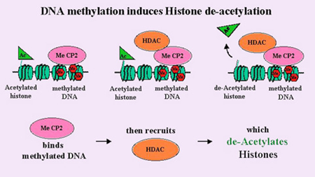
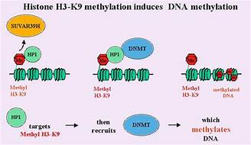
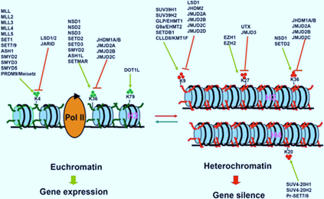
Cross Talk Between DNA Methylation and Histone Modifications
Notes:
DNA methylation can induce histone deacetylation and hence histone heterochromatinization and vice versa. Different histone codes are correlated with activation/deactivation of gene expression.
Here some histone marks act as active marks for gene expression whereas some represses gene expression.

Slide 9
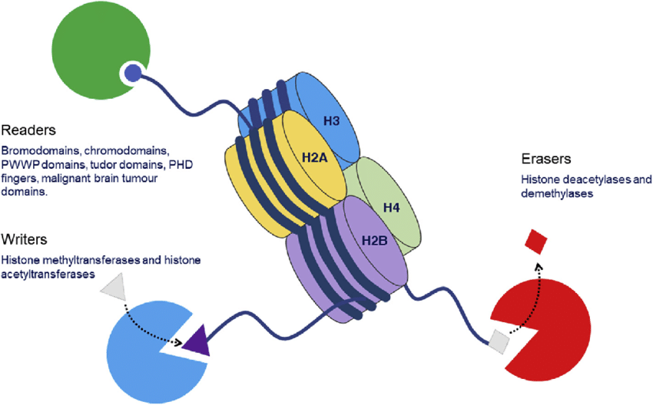
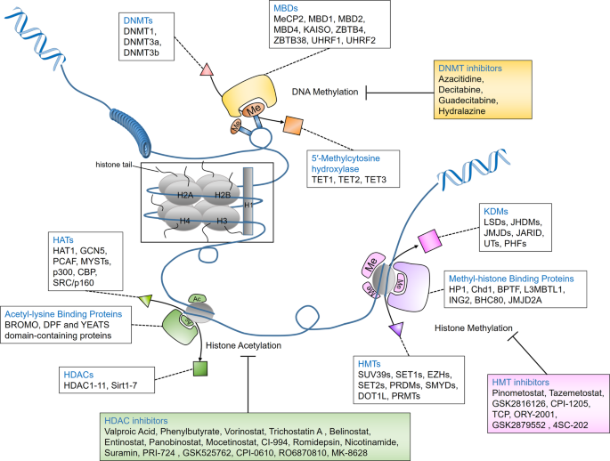
Gene Silencing in Mammalian Cells is usually Caused by Altered Expression of Different Epienzymes i.e. the Writers and Erasers
The “writers” (DNMTs, HATs, and HMTs)
“Erasers” (DNA-demethylating enzymes, HDACs, and KDMs)
Notes:
Gene silencing or activation is the effect of altered expression of writers and eraser.

Slide 10
Status Of Writers And Erasers In Cancer
Overexpression of DNMT1, DNMT3a, and DNMT3b has been observed in multiple cancers, which leads to gene silencing (TSG) by promoter hypermethylation.
The tumor suppressor p53 and p21 two representative substrates of HDACs, that are inactivated through deacetylation in various cancers.
Appropriate acetylation within cells is important since upregulation or downregulation of HATs is associated with tumorigenesis or poor prognosis.
lysine methylation at H3K9, H3K27, and H4K20 by HMT is generally associated with suppression of gene expression,
The “writers” (DNMTs, HATs, and HMTs)
“Erasers” (DNA-demethylating enzymes, HDACs, and KDMs)
https://www.nature.com/articles/s41392-019-0095-0#Tab1
Notes:
Different writers such as DNMTs, and HDAC are found to be upregulated in different cancers.

Slide 11
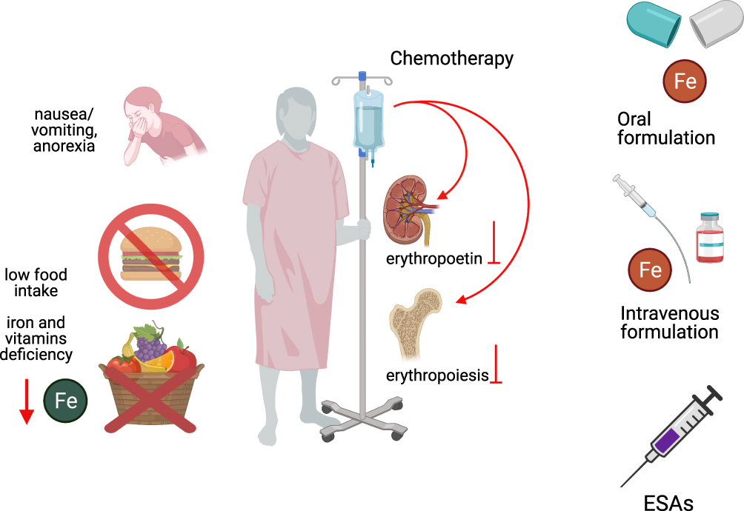
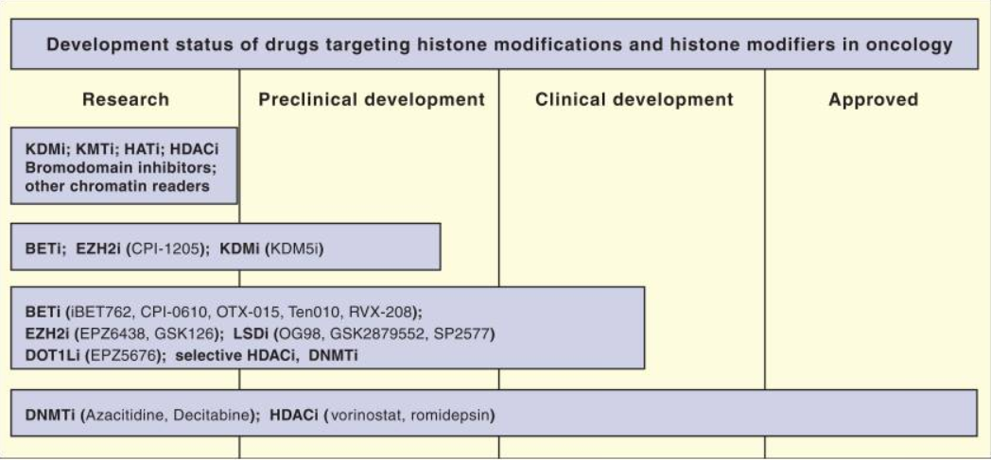
Side Effects Associated with Chemotherapeutics
and Epigenetic Drugs
Side effects of chemotherapy and Epigenetic drugs
Notes:
Although both chemotherapeutics and epigenetic inhibitors are used for conventional treatment, however, due to their non-specificity and serious side effects such as Alopecia, neuropathy, diarrhea, etc., an alternative strategy with a differential response is always in demand.

Slide 12
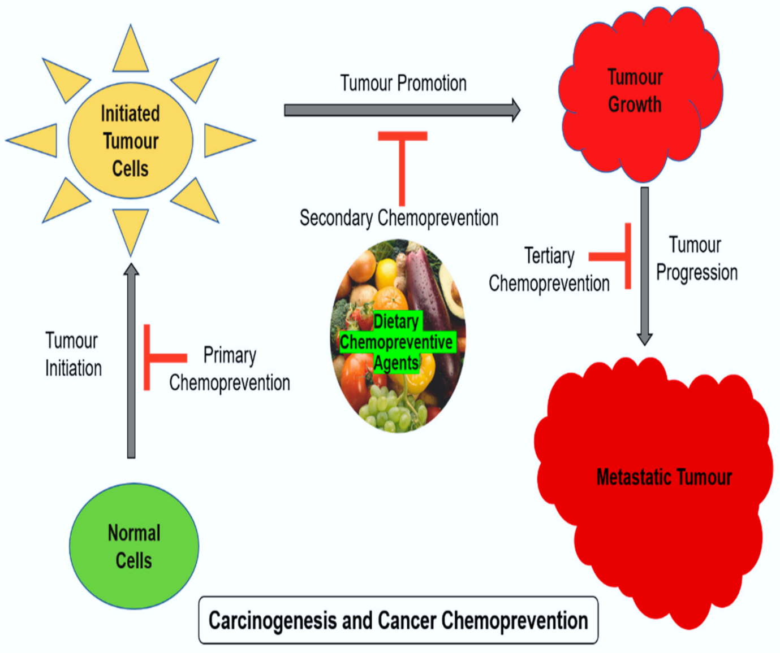
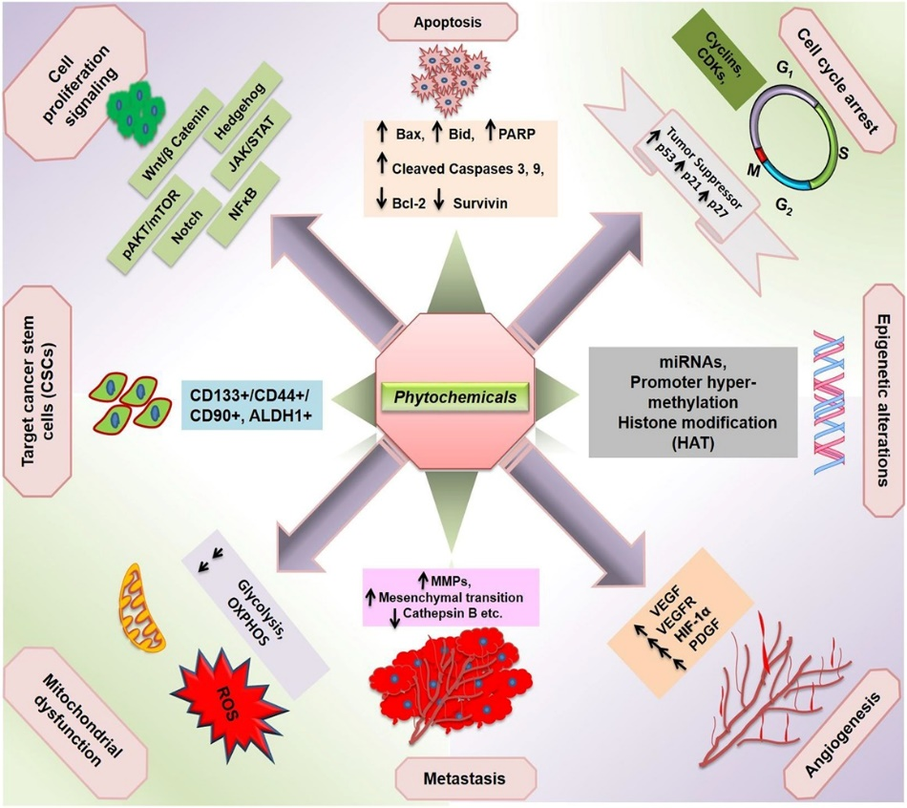
Chemoprevention as an Alternative/Adjuvant
to Overcome Side Effects Associated with
Chemotherapy
Blassan P. George et al, 2021; MDPI
Notes:
One strategy is chemoprevention i.e. use of dietary polyphenols which can target different cancer hallmarks as well as different stages of cancer to reverse carcinogenesis

Slide 13
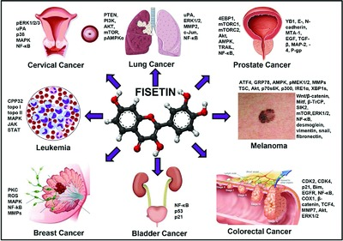
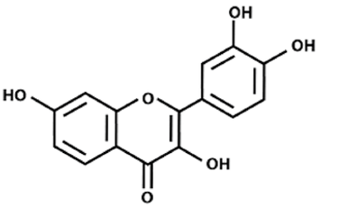
Agent used in this Study-Fisetin

Slide 14
Aim: To Analyze the Epigenetic Modulation
by Fisetin in Hela Cells
Objectives:
1. To study the effects of Fisetin treatment on methylation status of TSG in HeLa cells.
2. To study the modulatory action of fisetin on various molecular targets.
3. To study the effect of fisetin on migratory ability of HeLa cells.

Slide 15
Materials and Methods
$$+$$
Treatment with Fisetin
Epigenetic modulation
Molecular Biology assays
Bio-chemical assays
Cell-based assays
DNA isolation
TSG promoter methylation by methyl sequencing
qRT-PCR array of chromatin modifying genes, TSG and oncogene expression
Proteome profiler for migratory genes and TGFb pathway
DNMT activity assay
HDAC activity assay
Global methylation assay
Scratch wound and invasion assay
Colony formation assay
Statistical Analysis: One way/Two-way ANOVA and t-test was computed using GraphPad prism (version 9.3.1) software for comparisons, followed by Tukey's post hoc test. Data are presented as the mean ± standard deviation of three independent experiments*= P < 0.05; ** = P < 0.01, *** P < 0.001.
Notes:
to complete the objective the given methodology was followed

Slide 16
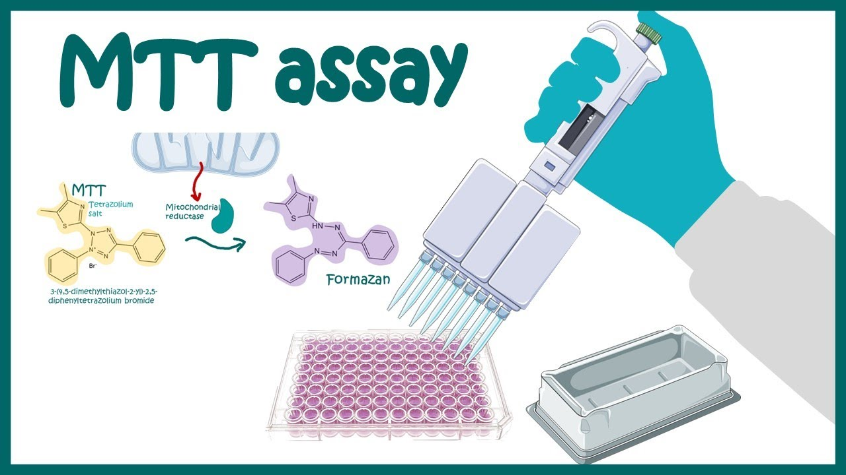
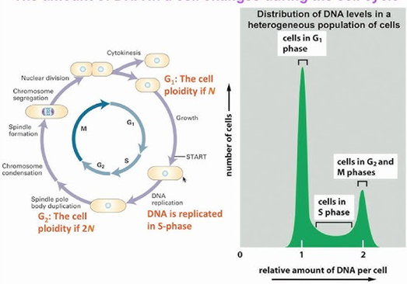
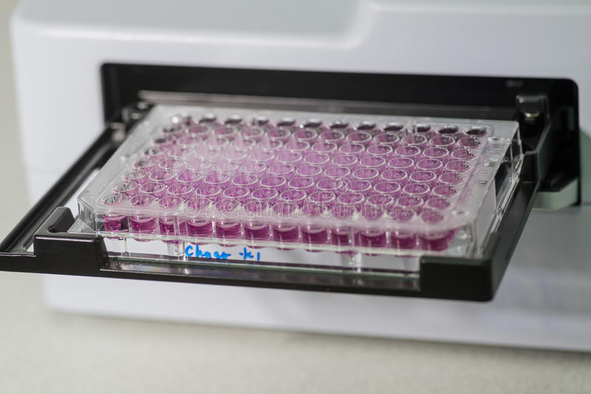
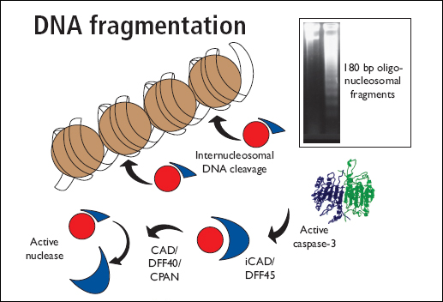
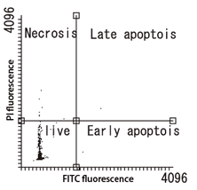
Results and Discussion
Notes:
Various assay such as MTT, flow cytometry, DNA fragmentation, fluorescence-based studies was done to comprehensively analyze the apoptosis inducing properties of fisetin and kaempferol.

Slide 17
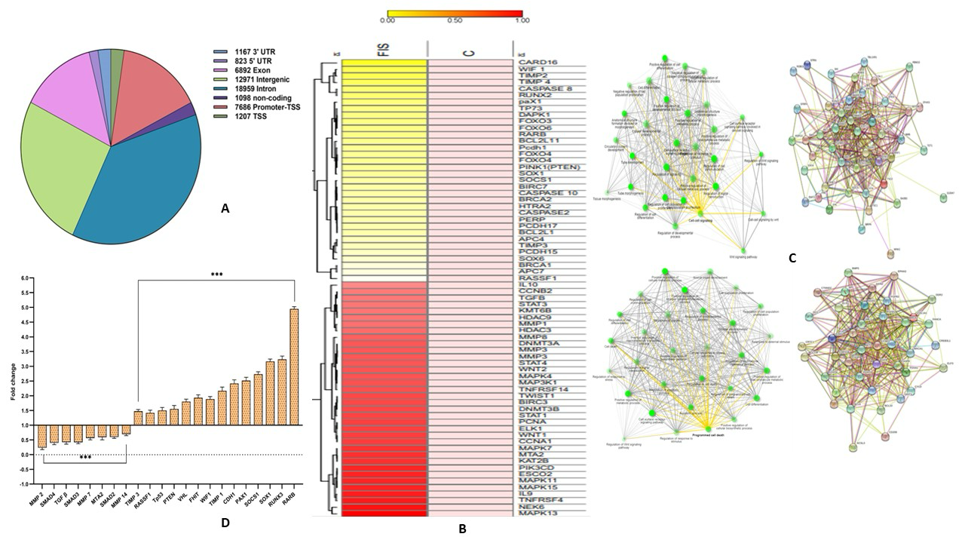
Fisetin Altered Methylation of Different
Genes Involved in Various Cellular Functions

Slide 18
Fisetin Downregulated the Expression of
Epigenetic Enzymes at Transcript Level
Place your data in this space

Slide 19
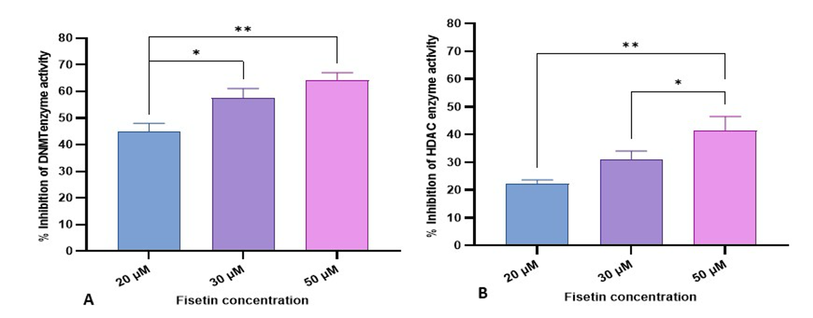
Fisetin Reduced the Biochemical Activity of DNMT and HDAC

Slide 20
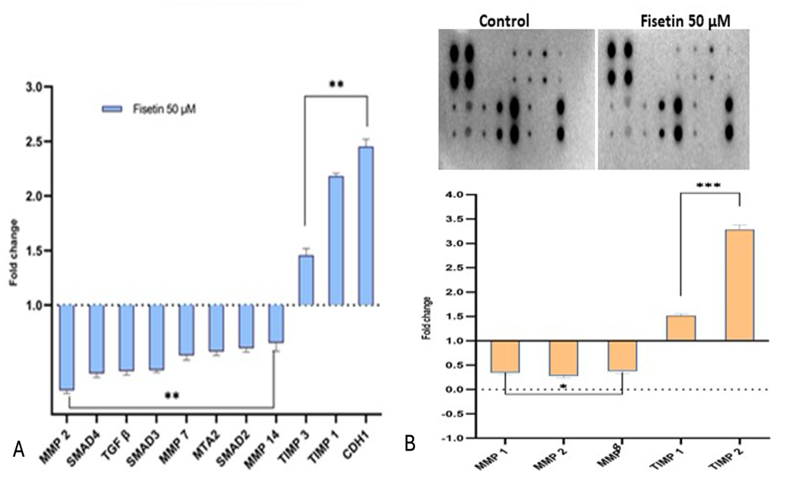
Fisetin Modulated the Expression of Genes Associated with Migration
Place your data in this space

Slide 21
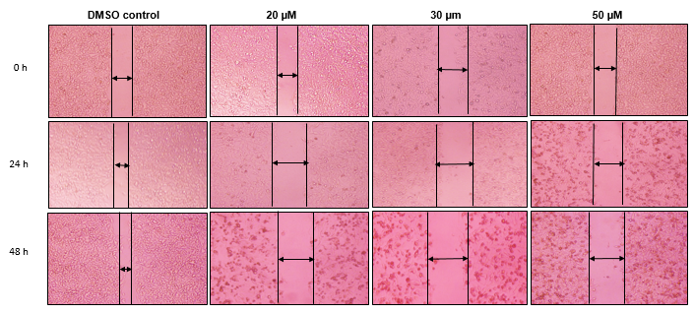
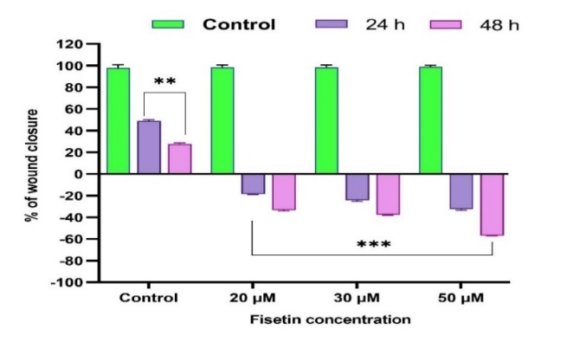
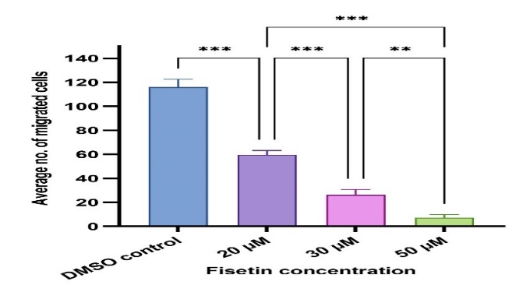
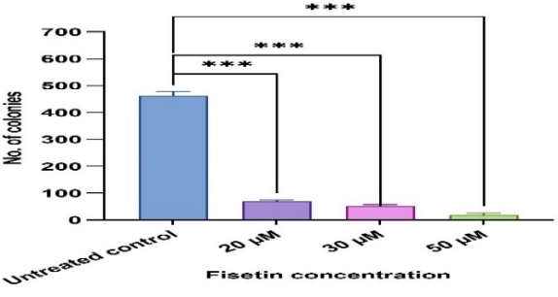
Fisetin Reduced Migratory and Clonogenic
Activity in Hela Cell
Notes:
The anti-migratory effect of fisetin was established as the treated cells the wound width was found to be increased in dose and time dependent mode which is further confirmed by invasion assay (as the number of migrated cells were reduced in dose dependent manner). Fisetin treatment also reduced the number of colonies significantly.

Slide 22
Conclusion
Fisetin demonstrated a strong demethylating effect on promoter region of different tumor suppressor genes such as RASSF1, RUNX, RARβ, SOCS1, FHIT to name a few that consequently leads to the reactivation.
Fisetin modulated expression and activity of epigenetic enzymes such as DNMT, HDAC, HMT etc.
Fisetin downregulated the expression of various migratory gene
At cell-based studies fisetin inhibited migration and invasive ability of HeLa cells.

